Slide 1


Slide 2
In The Beginning
Designed for Life

Slide 3
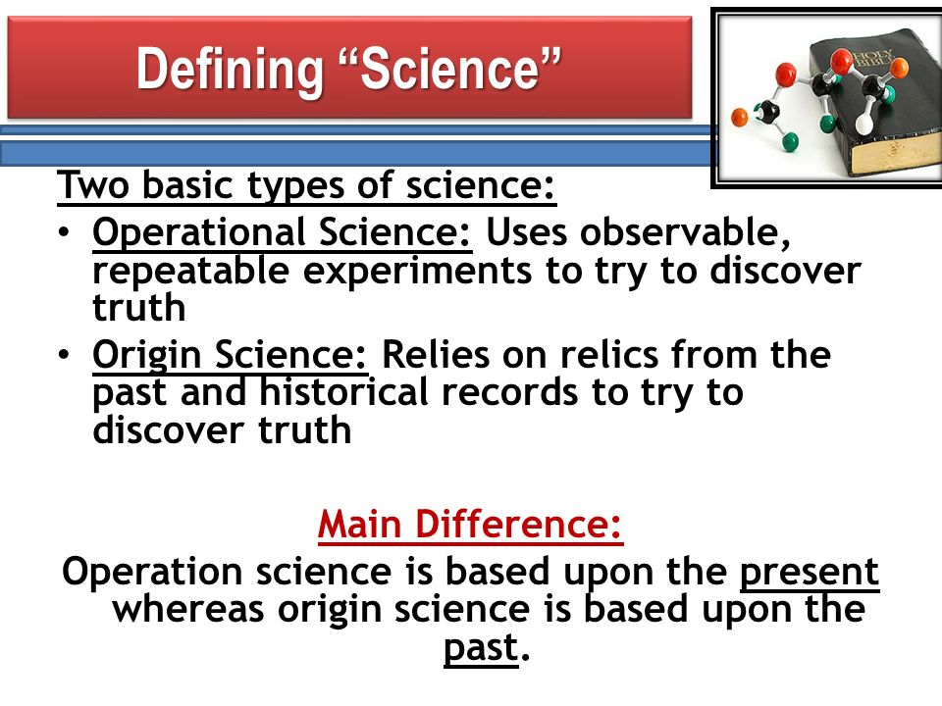

Slide 4
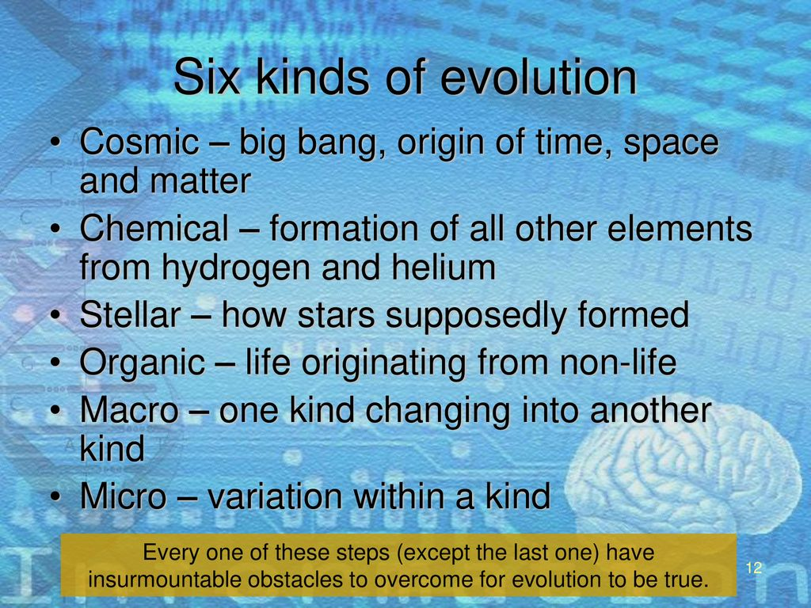

Slide 5
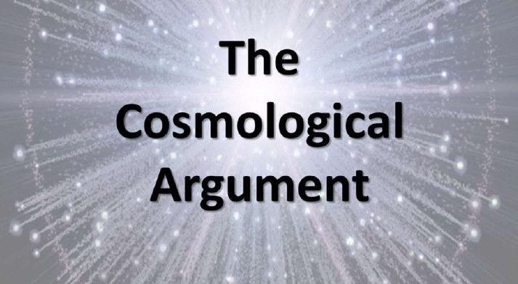

Slide 6
Designed for Life
REASON #1 —
The Cosmological Argument — The Uncaused First Cause of the Universe
[Psalm 90:2]

Slide 7
Designed for Life
REASON #2 —
The Teleological Argument — The Beauty, Complexity, and Design of the Universe
[Psalm 8]

Slide 8


Slide 9


Slide 10
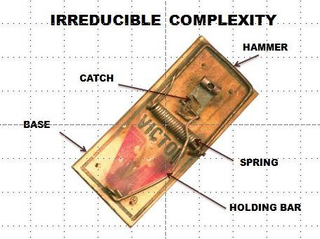

Slide 11
Designed for Life
REASON #3 —
The Anthropic Principle — The Fine Tuning of the Universe [Psalm 19:1-6]
[Isaiah 45:12-18]

Slide 12


Slide 13


Slide 14
Designed for Life
REASON #4 —
Information Theory — The Language of Life
[Psalm 139:1-18]

Slide 15
Designed for Life
Putting the Word into Practice
Commit to study to show yourself approved unto God and always be prepared to give a defense for WHY you believe in the God of the Word and in the Word of God.

